Slide 1
Texture Analysis

Slide 2
What is Texture?
Texture is a feature used to partition images into regions of interest and to classify those regions.
Texture provides information in the spatial arrangement of colours or intensities in an image.
Texture is characterized by the spatial distribution of intensity levels in a neighborhood.

Slide 3
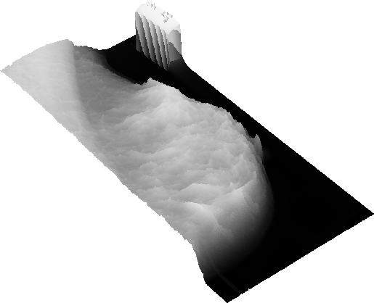
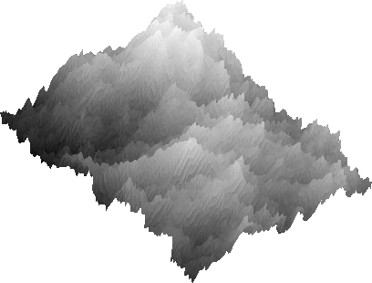
What is Texture?
Texture is a repeating pattern of local variations in image intensity:
– Texture cannot be defined for a point.

Slide 4



What is Texture?
For example, an image has a 50% black and 50% white distribution of pixels.
Three different images with the same intensity distribution, but with different textures.

Slide 5
Texture
Texture consists of texture primitives or texture elements, sometimes called texels.
Texture can be described as fine, coarse, grained, smooth, etc.
Such features are found in the tone and structure
of a texture.
Tone is based on pixel intensity properties in the texel, whilst structure represents the spatial relationship between texels.

Slide 6
Texture
If texels are small and tonal differences between texels are large a fine texture results.
If texels are large and consist of several pixels, a coarse texture results.

Slide 7
Texture Analysis
There are two primary issues in texture analysis:
texture classification
texture segmentation
Texture segmentation is concerned with automatically determining the boundaries between various texture regions in an image.
Good Reference
Reed, T.R. and J.M.H. Dubuf, CVGIP: Image Understanding, 57: pp. 359-372. 1993.

Slide 8
Texture Classification
Texture classification is concerned with identifying a given textured region from a given set of texture classes.
Each of these regions has unique texture characteristics.
Statistical methods are extensively used.
e.g. GLCM, contrast, entropy, homogeneity

Slide 9
Defining Texture
There are three approaches to defining exactly what texture is:
Structural: texture is a set of primitive texels in some regular or repeated relationship.
 Statistical: texture is a quantitative measure of the arrangement of intensities in a region. This set of measurements is called a feature vector.
Modelling: texture modelling techniques involve constructing models to specify textures.

Slide 10
Defining Texture
Statistical methods are particularly useful when the texture primitives are small, resulting in microtextures.
When the size of the texture primitive is large, first determine the shape and properties of the basic primitive and the rules which govern the placement of these primitives, forming macrotextures.

Slide 11
Simple Analysis of Texture

Slide 12
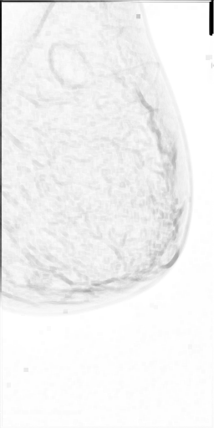
Range
One of the simplest of the texture operators is the range or difference between maximum and minimum intensity values in a neighborhood.
– The range operator converts the original image to one in which brightness represents texture.

Slide 13
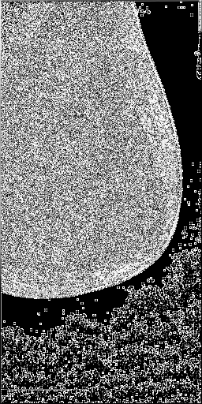
Variance
Another estimator of texture is the variance in neighborhood regions.
– This is the sum of the squares of the differences between the intensity of the central pixel and its neighbours.

Slide 14
Quantitative Texture Measures
Numeric quantities or statistics that describe a texture can be calculated from the intensities (or colours) themselves

Slide 15
Grey Level Co-occurrence
The statistical measures described so far are easy to calculate, but do not provide any information about the repeating nature of texture.
A gray level co-occurrence matrix (GLCM) contains information about the positions of pixels having similar gray level values.

Slide 16
GLCM
A co-occurrence matrix is a two-dimensional array, P, in which both the rows and the columns represent a set of possible image values.
– A GLCM P_{d}[i,j] is defined by first specifying a displacement vector d=(dx,dy) and counting all pairs of pixels separated by d having gray levels i
and j.
– The GLCM is defined by:
P_{d} [i, j ] = n_{ij}

Slide 17
GLCM
where n_{ij} is the number of occurrences of the pixel values (i,j) lying at distance d in the image.
The co-occurrence matrix P_{d} has dimension n×n, where n is the number of gray levels in the image.

Slide 18
GLCM
For example, if d=(1,1)
i
j
2 | 1 | 2 | 0 | 1
0 | 2 | 1 | 1 | 2
0 | 1 | 2 | 2 | 0
1 | 2 | 2 | 0 | 1
2 | 0 | 1 | 0 | 1
 | 0 | 2 | 2 | 0
P_{d} = | 2 | 1 | 2 | 1 | i
 | 2 | 3 | 2 | 2
 | 0 | 1 | 2
 |  | j
there are 16 pairs of pixels in the image which satisfy this spatial separation. Since there are only three gray levels, P[i,j] is a 3×3 matrix.

Slide 19
GLCM
Algorithm:
Count all pairs of pixels in which the first pixel has a value i, and its matching pair displaced from the first pixel by d has a value of j.
This count is entered in the i^{th} row and j^{th} column of the matrix P_{d}[i,j]
Note that P_{d}[i,j] is not symmetric, since the number of pairs of pixels having gray levels [i,j] does not necessarily equal the number of pixel pairs having gray levels [j,i].

Slide 20
Normalised GLCM
The elements of P_{d}[i,j] can be normalised by dividing each entry by the total number of pixel pairs.
Normalised GLCM; N[i,j], defined by:
P[i, j ]
∑∑P[i, j ]
i j
N[i, j ] =
which normalises the co-occurrence values to lie between 0 and 1, and allows them to be thought of as probabilities.

Slide 21
Numeric Features of GLCM
Gray level co-occurrence matrices capture properties of a texture but they are not directly useful for further analysis, such as the comparison of two textures.
Numeric features are computed from the co- occurrence matrix that can be used to represent the texture more compactly.

Slide 22
Maximum Probability
This is simply the largest entry in the matrix, and corresponds to the strongest response.
– This could be the maximum in any of the matrices or the maximum overall.
C_{m} = max P_{d} [i, j ]
i , j

Slide 23
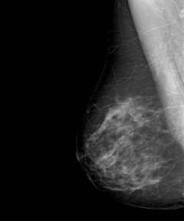
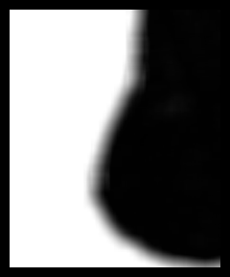
Maximum Probability
Maximum probability with w=21, and d=(2,2)

Slide 24
Moments
The order k element difference moment can be defined as:
Mom =
k ∑∑
k
(i − j ) P [i, j ]
d
i j
This descriptor has small values in cases where the largest elements in P are along the principal diagonal. The opposite effect can be achieved using the inverse moment.
_{= ∑∑} P_{d} [i, j ] _{, i ≠ j}
Mom
k
(i − j )^{k}
i j

Slide 25
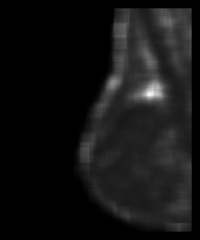
Moments
Moments with w=21, and d=(2,2)

Slide 26
Contrast
Contrast is a measure of the local variations present in an image.
C(k,n) =
∑∑
k
n
(i − j ) P [i, j ]
d
i j
If there is a large amount of variation in an image the P[i,j]’s will be concentrated away from the main diagonal and contrast will be high.
(typically k=2, n=1)

Slide 27
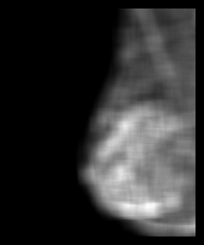
Contrast
Contrast with w=21, and d=(2,2)

Slide 28
Homogeneity
A homogeneous image will result in a co- occurrence matrix with a combination of high and low P[i,j]’s.
_{= ∑∑} P_{d} [i, j ]
C
h
1+ i − j
i j
Where the range of graylevels is small the P[i,j] will tend to be clustered around the main diagonal.
A heterogeneous image will result in an even spread of P[i,j]’s.

Slide 29
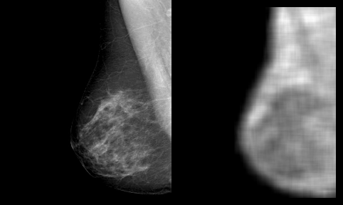
Homogeneity
Homogeneity with w=21, and d=(2,2)

Slide 30
Entropy
Entropy is a measure of information content. It measures the randomness of intensity distribution.
C_{e} = −∑∑P_{d} [i, j ]lnP_{d} [i, j ]
i j
Such a matrix corresponds to an image in which
there are no preferred graylevel pairs for the distance vector d.
Entropy is highest when all entries in P[i,j] are of similar magnitude, and small when the entries in P[i,j] are unequal.

Slide 31
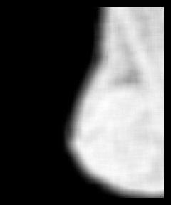
Entropy
Entropy with w=21, and d=(2,2)

Slide 32
∑∑[ijP_{d} [i, j ]] − μ_{i} μ _{j}
Correlation
Correlation is a measure of image linearity
C =
i j
c
ο σ
i j
μ =
∑ ∑
iP [i, j ], σ
= i P [i, j ] − μ
2
i d i
2 2
i
d
Correlation will be high if an image contains a considerable amount of linear structure.

Slide 33
GLCM - References
Carlson, G.E. and W.J. Ebel. "Co-occurrence matrix modification for small region texture measurement and comparison". in IGARSS'88- Remote Sensing: Moving Towards the 21st Century, pp.519-520, IEEE, Edinburgh, Scotland. 1988.
Argenti, F., L. Alparone, and G. Benelli, "Fast algorithms for texture analysis using co-occurrence matrices". IEE Proceedings, Part F: Radar and SIgnal Processing, 137(6): pp. 443-448. 1990.
Gotlieb, C.C. and H.E. Kreyszig, "textur descriptors based on co- occurrence matrices". Computer Vision, Graphics and Image Processing, 51(1): pp. 70-86. 1990.

Slide 34
Haralick Texture Operator
Haralick et al. suggested a set of 14 textural features which can be extracted from the co- occurrence matrix, and which contain information about image textural characteristics such as homogeneity, linearity, and contrast.
Haralick, R.M., K. Shanmugam, and I. Dinstein, "Textural features for image classification". IEEE Transactions on Systems, Man and Cybernetics: pp. 610-621. 1973.

Slide 35
Graylevel Difference Statistics
Grey-level differences are based on absoute differences between pairs of grey-levels.
The grey-level differences are contained in a 256-element vector, and are computed by taking the absolute differences of all possible pairs of grey levels distance d apart at angle
θ, and counting the number of times the difference is 0,1,…,255

Slide 36
Graylevel Difference Statistics
Let d=(dx,dy) be the displacement vector between two image pixels, and g(d) the gray- level difference at distance d.
g(d ) = f (i, j ) − f (i + dx, j + dy )
p_{g}(g,d) is the histogram of the gray-level differences at the specific distance, d. One distinct histogram exists for each distance d.

Slide 37
Graylevel Difference Statistics
The difference statistics are then normalized by dividing each element of the vector by the number of possible pixel pairs.
Several texture measures can be extracted from the histogram of graylevel differences:

Slide 38
Graylevel Difference Statistics
Mean:
N
μ_{d} = ∑g_{k} p_{g} (g_{k} ,d )
k =1
– Small mean values μ_{d} indicate coarse texture having a grain size equal to or larger than the magnitude of the displacement vector.
Entropy:
N
H_{d} = −∑ p_{g} (g_{k} ,d )ln p_{g} (g_{k} ,d )
k =1
– This is a measure of the homogeneity of the
histogram. It is maximised for uniform histograms.

Slide 39
Graylevel Difference Statistics
Variance:
N
ο = ∑(g
2
− μ ) p (g ,d )
2
d k d g k
k =1
– The variance is a measure of the dispersion of the gray-level differences at a certain distance, d.
Contrast:
N
C = ∑g ² p (g ,d )
k g k
k =1
d

Slide 40
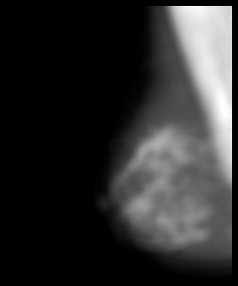
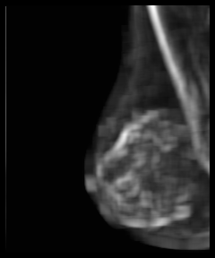
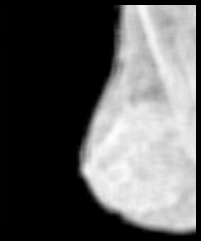
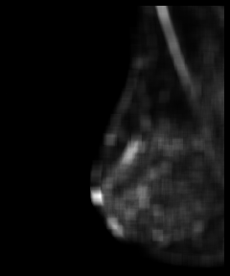
Graylevel Difference Statistics
Mean
Standard Deviation
Entropy
Contrast

Slide 41
Runlength Statistics
The lengths of texture primitives in different directions can serve as a texture description.
– A run length is a set of constant intensity pixels located in a line.
Runlength statistics are calculated by counting the number of runs of a given length (from 1 to n) for each grey level.
Galloway, M.M., "Texture classification using gray level run lengths". Computer Graphics and Image Processing, 4(2): pp. 172-179. 1975.

Slide 42
Runlength Statistics
In a course texture it is expected that long runs will occur relatively often, whereas a fine texture will contain a higher proportion of short runs.
Statistical measures:
– Let B(a,r) be the number of primitives of all directions having length r, and grey-level a, m and
n the image dimensions, and L the _{L}nu_{N}m_{r} ber of
K = ∑∑B(a,r )
a =1 r =1
intensity values.
– Let K be the number of runs:

Slide 43
Runlength Statistics
Long-run emphasis:
L Nr
S =
1
K
∑∑
B(a,r )r
2
lr
a =1 r =1
– This is a measure that emphasizes the long-runs of a gray- level image. Long-run emphasis will be large when there are lots of long runs of the same intensity.
 Short-run emphasis:
L Nr
∑∑
B(a,r )
S =
1
K
_{r} 2
sr
a =1 r =1
– This is a measure that emphasizes the short-runs of a gray- level image. short-run emphasis will be large when there are lots of short runs of the same intensity.

Slide 44
Runlength Statistics
Grey-level distribution:
L ⎡ Nr
⎤2
S =
1
K
∑ ∑
B(a,r )r
2
d
⎢ ⎥
a =1 ⎣ r =1 ⎦
– The sum in [ ] gives the total number of runs for a certain gray-level value grey-level a. The distribution will be large when runs are not evenly distributed over the different intensities.

Slide 45
Runlength Statistics
Run-length distribution:
⎤2
Nr
⎡
L
S =
1
K
∑ ∑
B(a,r )r
2
rd
⎢ ⎥
r =1 ⎣ a =1 ⎦
– The sum in [ ] gives the total number of occurrences of a certain run length l for any gray level. s for a certain gray- level value grey-level r.
 Run percentage:
K
S =
rp
mn

Slide 46
Edges and Texture
It should be possible to locate the edges that result from the intensity transitions along the boundary of the texture.
Since a texture will have large numbers of texels, there should be a property of the edge pixels that can be used to characterise the texture.
a set of common directions
a measure of the locadensity of the edge pixels
Compute the co-occurrence matrix of an edge- enhanced image.
Davis, L.S. and A. Mitiche, "Edge detection in textures". Computer Graphics and Image Processing, 12: pp. 25-39. 1980.

Slide 47
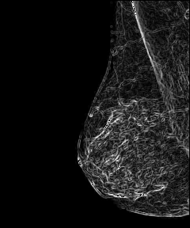
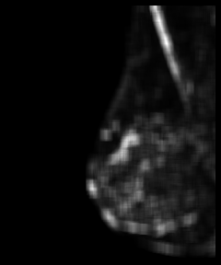
Edges and Texture
Original
Sobel-Enhanced
Contrast

Slide 48
Texture Segmentation
Any texture measure that provides a value, or a vector of values at each pixel, describing the texture in a neighborhood of that pixel can be used to segment an image into regions of similar textures.
There are two major categories:
Region-based: attempt to group or cluster pixels with similar texture properties
 Boundary-based: attempt to find “texture-edges” between pixels from different texture distributions

